Slide 1


Romanian NMA Training Placement Scheme
Second semestrial scientific report, October 2025
Claudiu Adam, Eugen Mihuleț
Bucharest, October 27th 2025

Slide 2
Content of the presentation
Data sources
Convective cell identification
Knowledge distillation strategy
Model fine-tuning
Grad-CAM & Xi methodology
Feature importance results
Key findings
Pre-trained COALITION-4
Distilled COALITION-4
Next steps
Bucharest, October 27th 2025

Slide 3
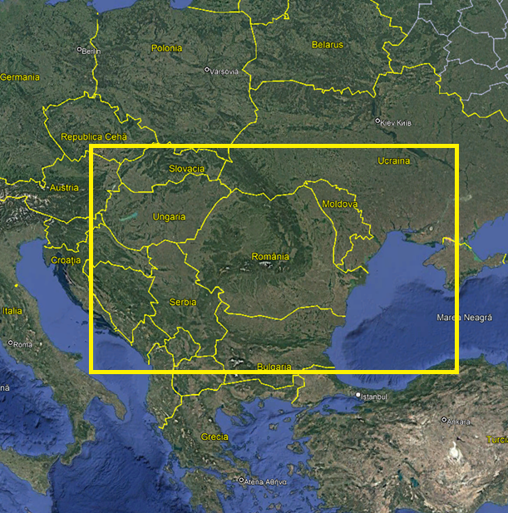
Data sources
Radar, satellite and NWCSAF products, lightning, NWP (ICON) integration
Stereo70 projection of Romania, border-inclusive extraction polygon
256×256 pixel patch extraction, standardized to 32×32 for processing
DBSCAN algorithm identifies convective cells
Area extent of model domain
Bucharest, October 27th 2025

Slide 4
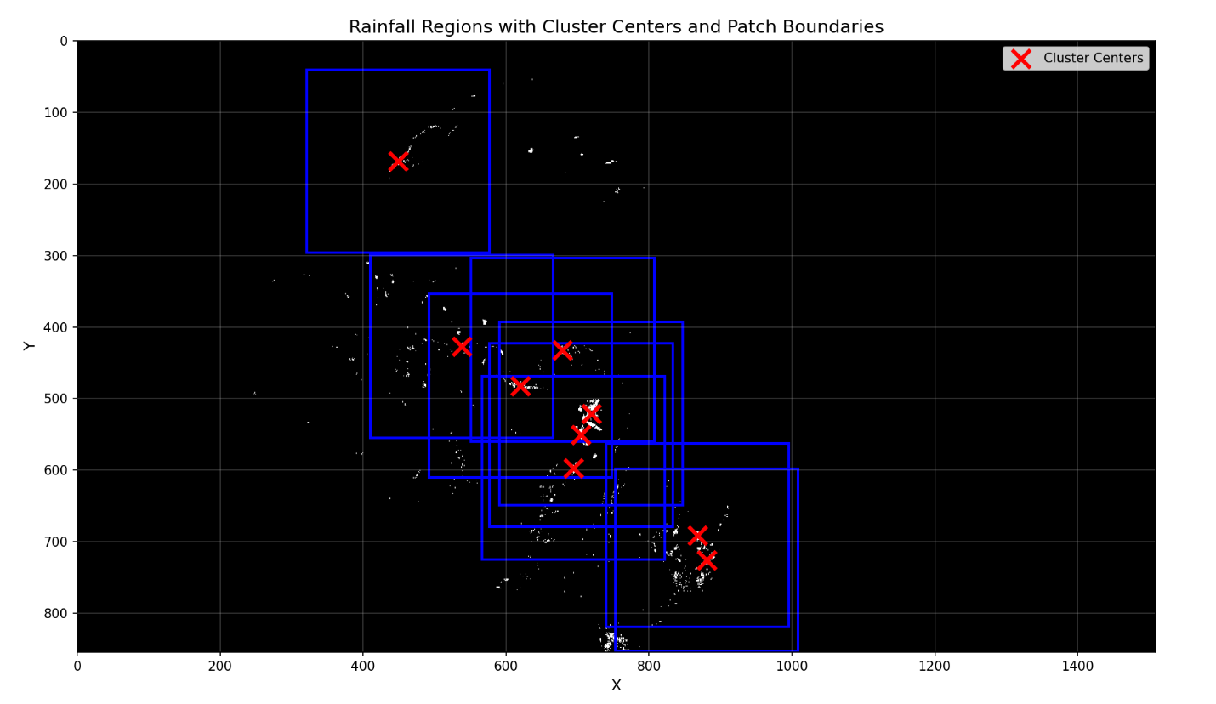
Convective cell identification
Applied to RZC reflectivity data
Centered 256×256 pixel patches around cluster centroids
Same patches extracted across all products
More control over target patch extraction process
Bucharest, October 27th 2025

Slide 5
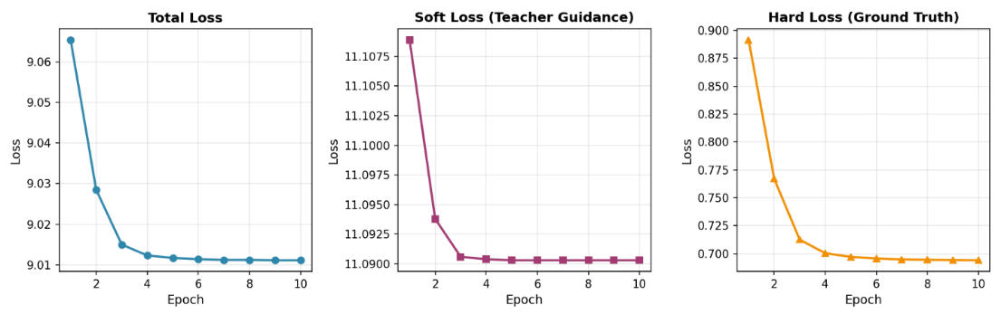
Knowledge distillation strategy
Teacher-student knowledge transfer from pre-trained COALITION-4 to randomly initialized COALITION-4, configured to work with Romanian data
Three-component loss = Hard (ground truth) + Soft (KL divergence) + feature matching
Stable training with hard loss dropping consistently from 0.89 to 0.70
Bucharest, October 27th 2025

Slide 6
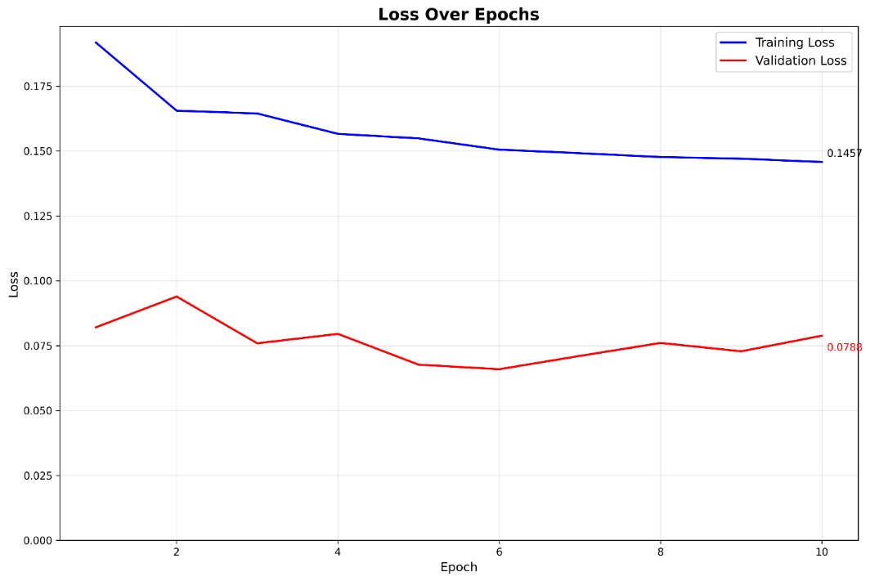
Model fine-tuning
Training loss decreases monotonically from 0.195 to 0.145
Spikes in validation learning curve due to small dataset size
Adam optimizer, weighted focal loss, learning rate 1e-5
Good generalization for 10 epochs - validation loss lower than training loss
Bucharest, October 27th 2025

Slide 7
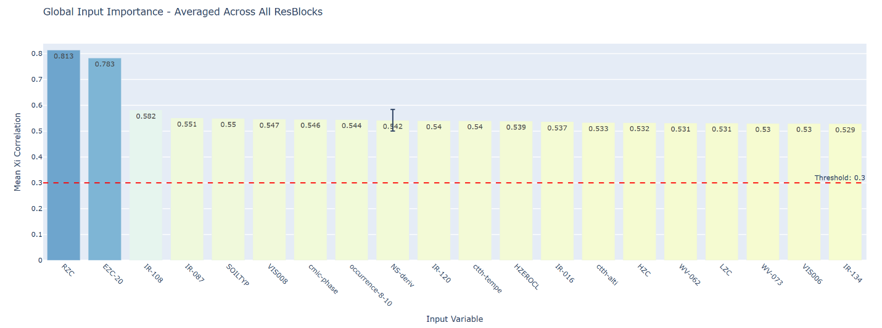
Grad-CAM & Xi methodology
Feature importance analysis through gradient-weighted activation maps
Xi correlation for nonlinear dependence measurement (0=independent, 1=dependent)
Combined approach for correlating input and output activation patterns
Features below threshold ξ < 0.52 removed for increased model efficiency
Global ranking reveals radar products far exceed others ξ_{RZC} = 0.813, ξ_{EZC-20} = 0.783
Bucharest, October 27th 2025

Slide 8
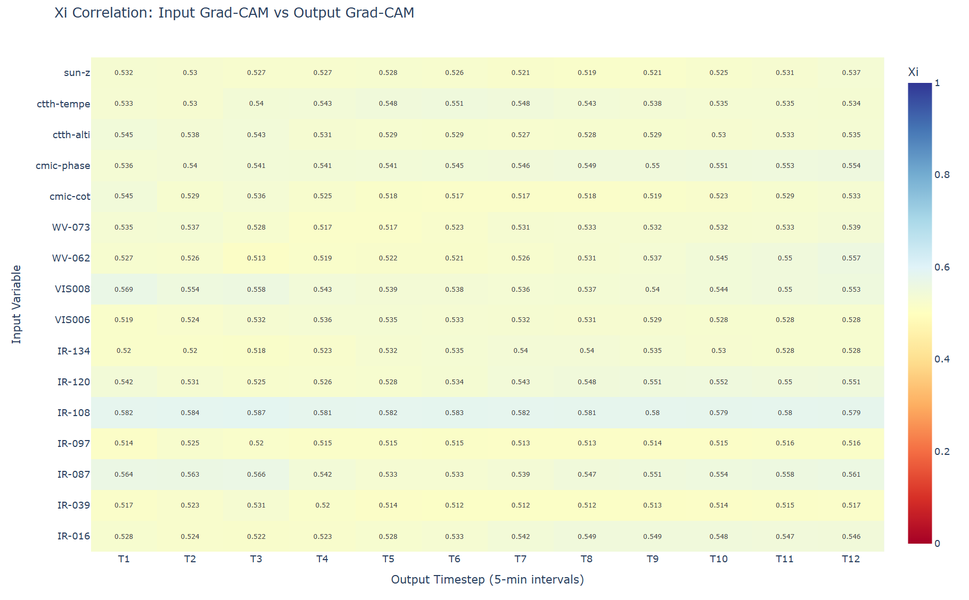
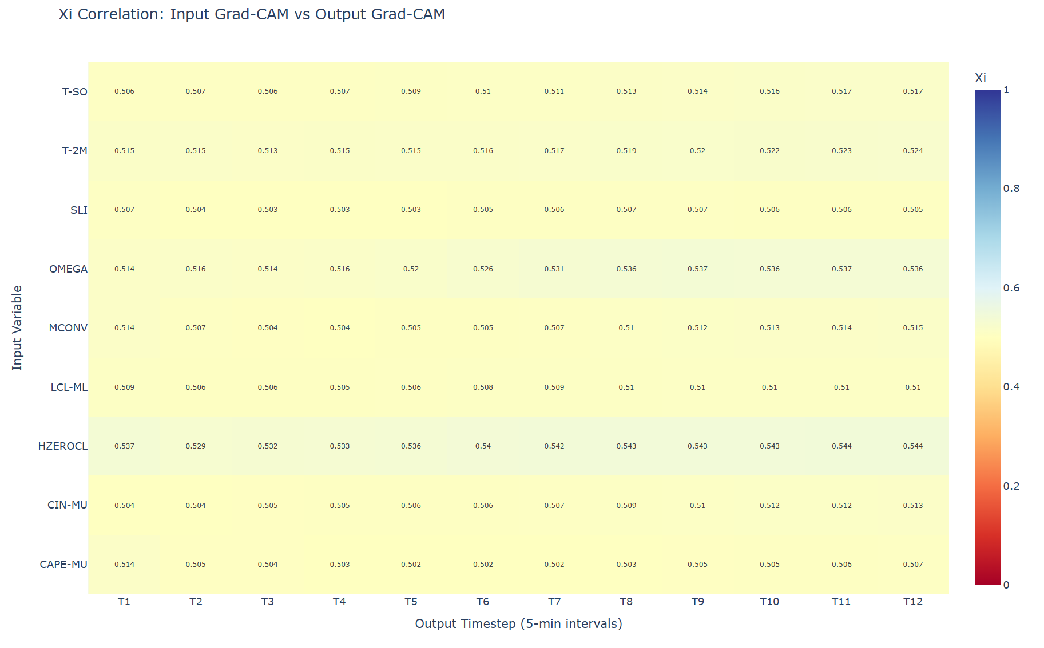
Feature importance results
Bucharest, October 27th 2025

Slide 9
Key findings
DEM confirmed detrimental, validates MeteoSwiss SHAP analysis
NWP marginally useful with ξ ≈ 0.52 but computationally expensive
Optimal feature set = Radar + Satellite + Lightning + NWCSAF, maintaining quality while decreasing overhead
Bucharest, October 27th 2025

Slide 10
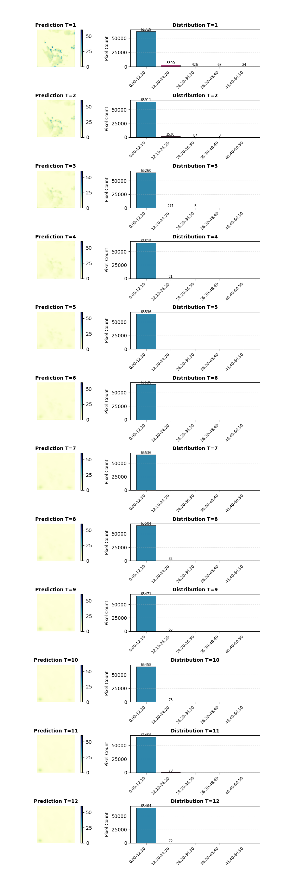
Pre-trained COALITION-4
Bucharest, October 27th 2025

Slide 11
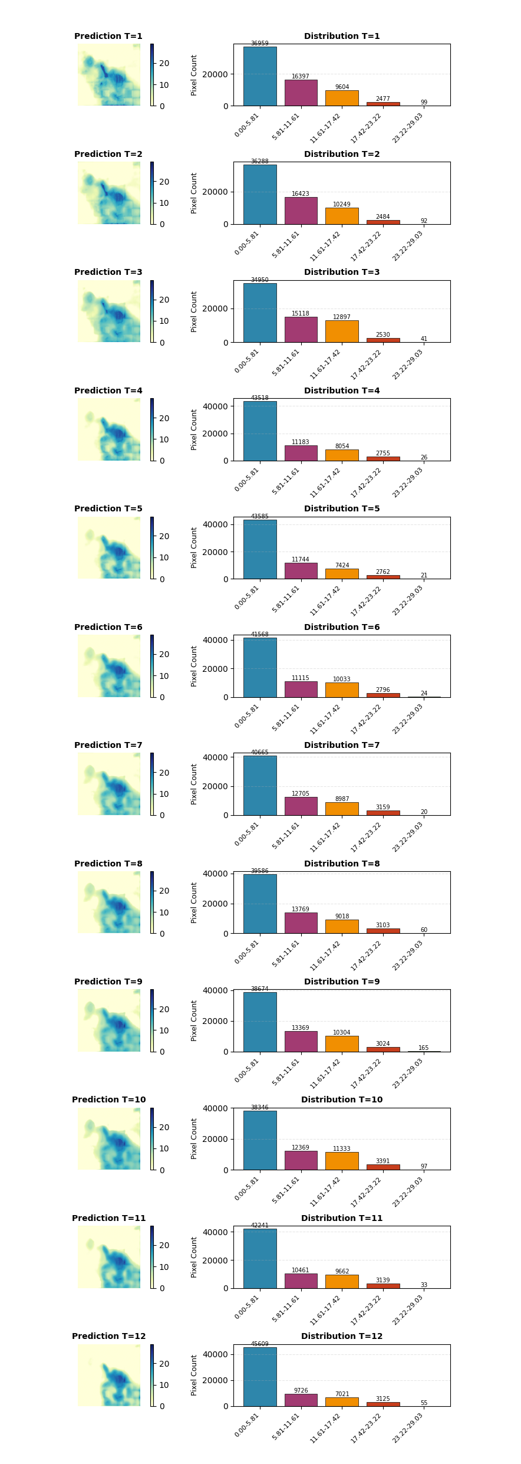
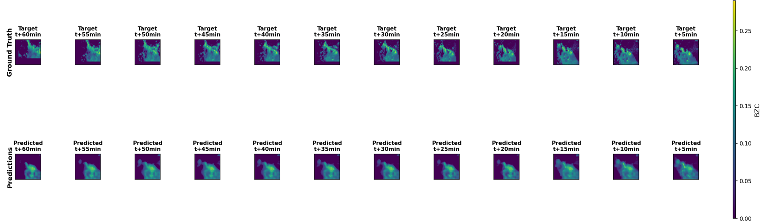
Distilled COALITION-4
Trained without NWP and DEM products
Bucharest, October 27th 2025

Slide 12
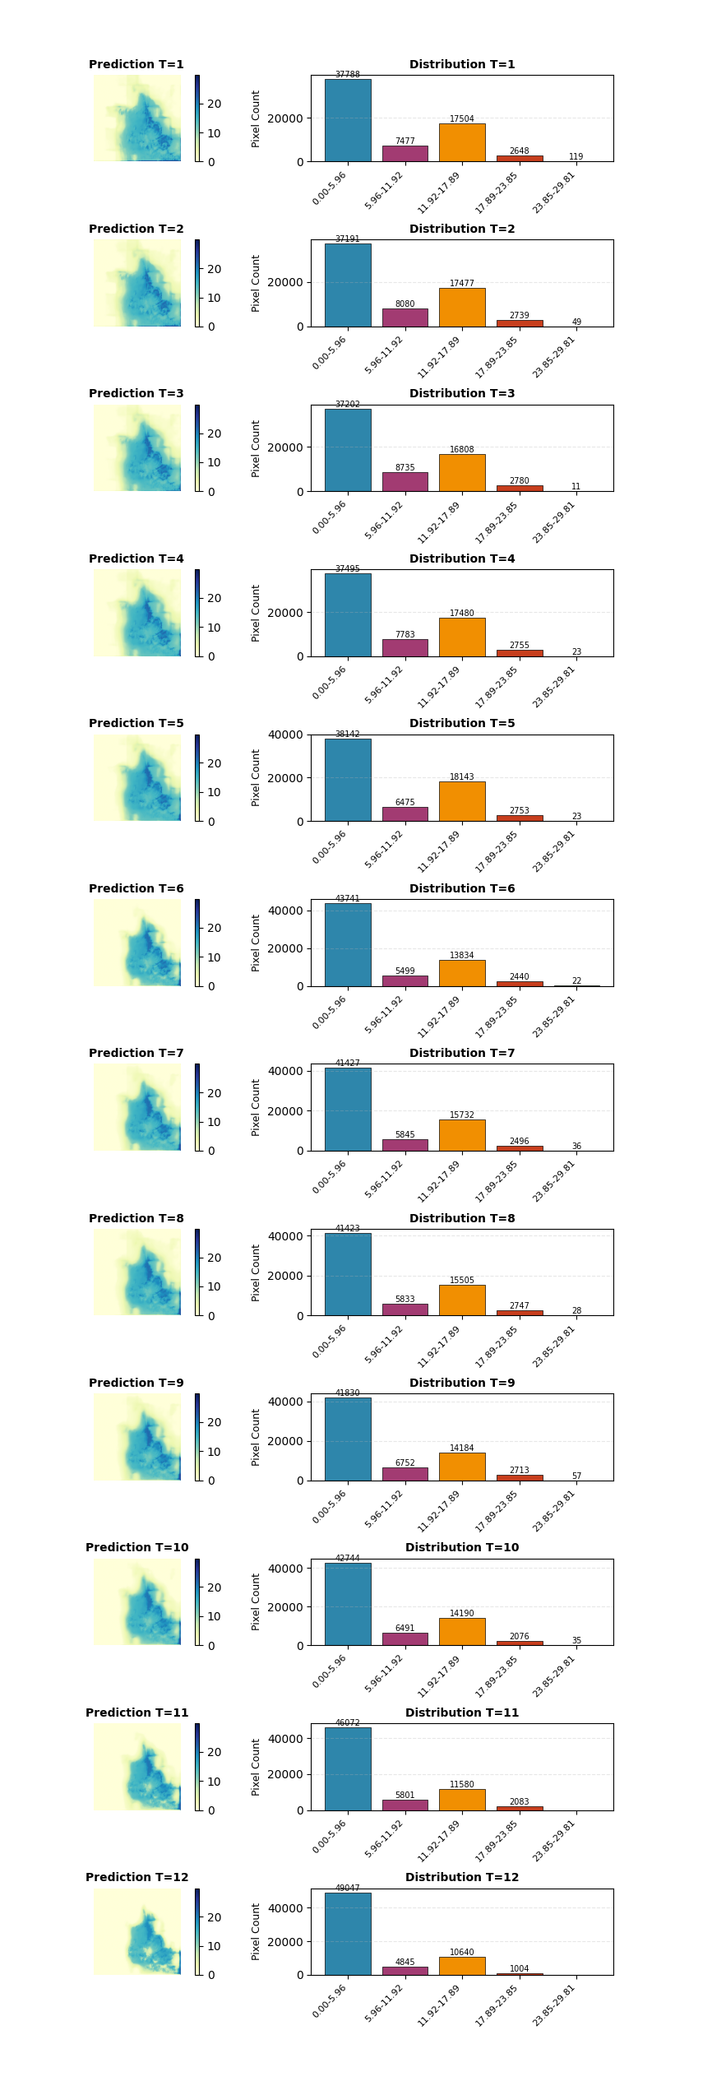
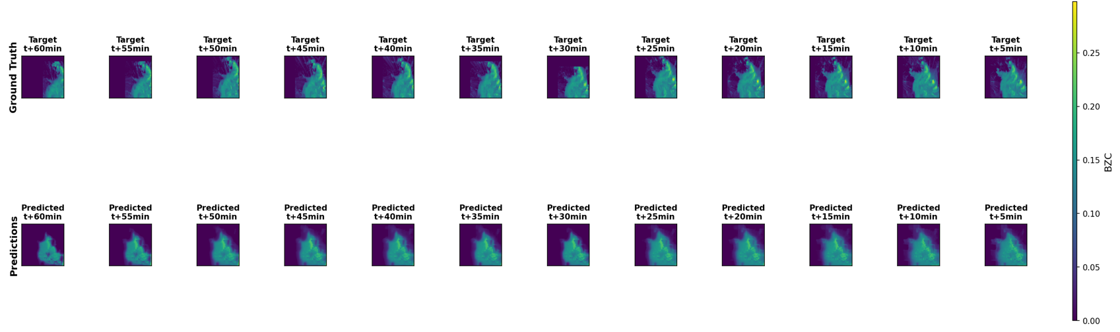
Distilled COALITION-4 – sample prediction
Core location maintained across lead times
Bucharest, October 27th 2025

Slide 13
Next steps
Evaluate improved spatial/temporal resolution benefits from transitioning to MTG
Integrating new FCI channels, Lightning Imager, enhanced RGB composites
Physics-based module for enhancing data-driven solution with atmospheric principles
Operational deployment on NMA’s local infrastructure + code modularity for ease of access by other European states
Bucharest, October 27th 2025

